Slide 1

Happiness
Building a meaningful life with Universal Human Values
Why it matters for Students and Educators

Slide 2
11.30 am- 12.30 am Followed by discussion/question and answers | Guest Lecture (For Faculty and PGDM ABM Students): Building a meaningful life with Universal Human Values: Why it matters for Students and Educators? by Sh. Rajul Asthana, Founder Trustee, UHV Foundation and Vice Chairman, National Committee for UHV (AICTE) and Dr. Sharmila Asthana, Author of “A Foundation Course in Holistic Human Health” Venue: Conference Hall, ICAR-NAARM
1-2 pm | Lunch
2pm to 4 pm | Towards Effective UHV Teaching at ICAR-NAARM: An Interaction meet between Dr. Rajul Asthana along with Dr. Sharmila Asthana and their team with the UHV faculty at ICAR-NAARM (Dr. K.N. Yamini, Dr. Dipesh Debnath, Dr. Mahantesh Shirur and Dr. T. Himabindu) Venue: Board Room, ICAR-NAARM

Slide 3
11:30 AM | Welcome address | Dr. K.N. Yamini, Principal Scientist, , ICAR-NAARM Specialisation in Genetics and plant breeding with a focus on agricultural education
11.35 AM | Director’s Remarks | Dr. Gopal Lal Meena, Director, ICAR-NAARM A distinguished scientist in sustainable agriculture from Rajasthan
11.45 AM | Building a meaningful life with Universal Human Values: Significance for Students and Educators | Shri. Rajul Asthana, Founder Trustee, UHV Foundation and Vice Chairman, National Committee for UHV (AICTE) and Dr. Sharmila Asthana, Founder Trustee, UHV Foundation and Author “A Foundation Course on Holistic Health”
12.40 PM | Discussion/Interaction | Students & Faculty
12:50 PM | Words of thanks | Dr. Mahantesh Shirur, Principal Scientist, ICAR-NAARM From Karnataka, he works on agricultural research, extension systems, and farmers' welfare

Slide 4
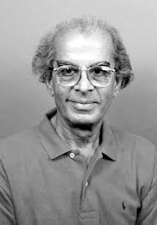
Remembering Dr. PS Ramakrishnan (Mausa ji)
Dialogue between
Traditional Knowledge (TK) and Formal Knowledge (FK)
‘most widely known for his pioneering work on traditional ecological knowledge, sustainable development, and the integration of indigenous land-use practices with modern environmental management.
  2001, Ecology and Sustainable Development in the Tropics, National Book Trust
  1998 Edited Series Traditional Ecological Knowledge for Managing Biosphere Reserves in South and Central Asia, UNESCO - South and Central Asian MAB Network (SACAM), New Delhi
What gets us into trouble is not just what we don’t know…
It’s what we “know” for sure that just isn’t true

Slide 5
Process – We will Explore on our Own Right
Whatever is said is a Proposal
Verify it on Your Own Right – on the basis of our Natural Acceptance
Do not assume it to be true or false
More

Slide 6
What do we Want? What is our Aspiration?
We want to live with continuous happiness and prosperity
Right Understanding
Relationship
Physical Facility
We want to live with happiness and prosperity
Relationship
Physical Facility
We want to live
Physical Facility
Check: If you want to
. Live with a feeling of relationship
. Live with a feeling of opposition
. Struggle for survival (because you believe that only the fittest survive)
Check: If incidences of reaction… not speaking to the other… arguments… debates… are taking place
Why are they happening when we do want to live with a feeling of relationship?
Are you aware of how many clothes you have?
Check: Is the unhappiness in your family
. More due to lack of physical facility or
. More due to lack of fulfillment in relationship?
We become uncomfortable and unhappy when there is lack of physical facility… but when we get the physical facility, we forget about it and start thinking of 100 other things! (something more is required!)
Should our education help us to meet this aspiration?
i.e., help us to be “Life Ready” vs just “Job Ready”?

Slide 7
Happiness

Slide 8
What Makes You Happy?
Happy?
Enjoying a tasty snack
Eating a very sour/bitter fruit
When someone is scolding you
When someone is praising you
When you can’t solve a tough problem
When you know the answer to all the questions
When you have a feeling of respect
When you have a feeling of disrespect
Unhappy?
Unhappy?
Happy?
Unhappy?
Happy?
Happy?
Unhappy?
Do you like to prolong to be in the state / situation which makes you happy?

Slide 9

Check – If all your efforts are to be Happy (or is it sometimes to be Unhappy also?)
Present Effort
(1)
Studying
Doing Internship
Attending Coaching
Doing Articleship
Doing MBA
Researching
Painting…
to Become?
(2)
an engineer
a doctor
a farmer
an artist
a teacher…
to Get/Do?
(3)
Get Money
Earn Name, Fame
Do Research, Innovation
Take care of parents
Make family/nation proud
Get Power in society
Earn Respect…
to Be?
(4)
To be happy and prosperous
In continuity!
Why?
Why?
Why?

Slide 10
Happiness
Unhappiness
Happiness = To be in a state of Harmony
(and we want to continue to be in that state)
Unhappiness = To be forced
to be in a state of Disharmony
(and we want to get out from that state)o

Slide 11
When we don’t understand Happiness, we may go for Excitement (temporary happiness)
Excitement
Pleasure (from favourable sensation)
Attention, appreciation… (favourable feelings) from others
Lack of responsibility
Eating delicious food
Listening to favourite music
Getting appreciation for looks, voice, clothes
Watching a thriller movie
Favourite team winning a match…
🥳
Dependence on outside, temporary, not definite, can’t be continuous

Slide 12
Excitement to Indulgence
Indulgence
Watching movies for long hours
Playing video games whole night
Partying with friends, Long drives
Addiction to
Smoking, alcohol, drugs…
No responsibility
🤤
Excitement
Pleasure (from favourable sensation)
Attention, appreciation… (favourable feelings) from others
Lack of responsibility
🥳
Dependence on outside, temporary, not definite, can’t be continuous

Slide 13
Excitement-Indulgence to Depression
Indulgence
Watching movies for long hours
Playing video games whole night
Partying with friends, Long drives
Addiction to
Smoking, alcohol, drugs…
No responsibility
🤤
Excitement
Pleasure (from favourable sensation)
Attention, appreciation… (favourable feelings) from others
Lack of responsibility
🥳
Depression
Insufficient pleasure (from favourable sensation)
Lack of attention, appreciation… (favourable feelings) from others
Hopelessness
Lack of responsibilty
😣
I did not get good marks
My friend ignored me…
Anger
Refusing food
Overeating
Becoming reclusive, suicidal thoughts
Not sharing, not communicating…
Dependence on outside, temporary, not definite, can’t be continuous

Slide 14
Excitement-Indulgence-Depression to Escape
Indulgence
Watching movies for long hours
Playing video games whole night
Partying with friends, Long drives
Addiction to
Smoking, alcohol, drugs…
No responsibility
Excitement
Pleasure (from favourable sensation)
Attention, appreciation… (favourable feelings) from others
Lack of responsibility
🤤
🥳
Depression
Insufficient pleasure (from favourable sensation)
Lack of attention, appreciation… (favourable feelings) from others
Frustration, Anxiety, Hopelessness
Lack of responsibilty
Escape
Overeating
Oversleeping
Addiction to
Smoking, alcohol, drugs…
No responsibility
😣
😩
Dependence on outside, temporary, not definite, can’t be continuous

Slide 15
Excitement-Depression to Happiness Desired State
Excitement
Pleasure (from favourable sensation)
Attention, appreciation… (favourable feelings) from others
Lack of responsibility
🥳
Happiness
Harmony
Right understanding
Right feeling
Responsibility
😊
Depression
Insufficient pleasure (from favourable sensation)
Lack of attention, appreciation… (favourable feelings) from others
Hopelessness
Lack of responsibility
😣
Continuous, definite
No fluctuations
No dependence on outside
Dependence on outside, temporary, not definite,
can’t be continuous

Slide 16
Right Understanding
We want to live with continuous happiness
Right Understanding
Relationship
Physical Facility

Slide 17
Right Understanding is Essential for Human Being
RIGHT UNDERSTANDING
(le>)
in the self
RELATIONSHIP (laca/k)
with human being
PHYSICAL FACILITY
(lqfo/kk)
with rest of nature
For animals: necessary & largely adequate
For human beings:
necessary but not adequate
Are all 3 required? Is something redundant? Is anything more required?
Are we working on all 3?
If all 3 are required, what would be the priority*?
*Working on the high priority facilitates the realisation of the lower priority

Slide 18
Priority: Right Understanding, Relationship & Physical Facility
1
RIGHT UNDERSTANDING
(le>)
in the self
2
3
For animals: necessary & largely adequate
RELATIONSHIP (laca/k)
with human being
PHYSICAL FACILITY
(lqfo/kk)
with rest of nature
Feeling
- Trust
- Respect
- …
For human beings:
necessary but not adequate

Slide 19
Priority: Right Understanding, Relationship & Physical Facility Desired State
1
RIGHT UNDERSTANDING
(le>)
in the self
2
3
For animals: necessary & largely adequate
RELATIONSHIP (laca/k)
with human being
PHYSICAL FACILITY
(lqfo/kk)
with rest of nature
Feeling
- Trust
- Respect
- …
For human beings:
necessary but not adequate
MUTUAL HAPPINESS
(mHk; lq[k)
MUTUAL PROSPERITY
(mHk; le`f))

Slide 20
Priority: Physical Facility
?
RIGHT UNDERSTANDING
(le>)
in the self
?
1
For animals: necessary & largely adequate
RELATIONSHIP (laca/k)
with human being
PHYSICAL FACILITY
(lqfo/kk)
with rest of nature
For human beings:
necessary but not
adequate
UNHAPPINESS
Making others Unhappy
DEPRIVATION
Exploiting and
Depriving others

Slide 21
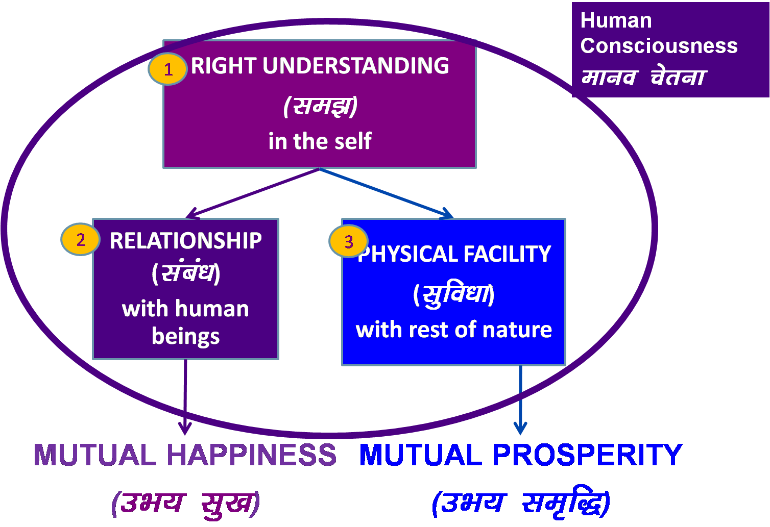
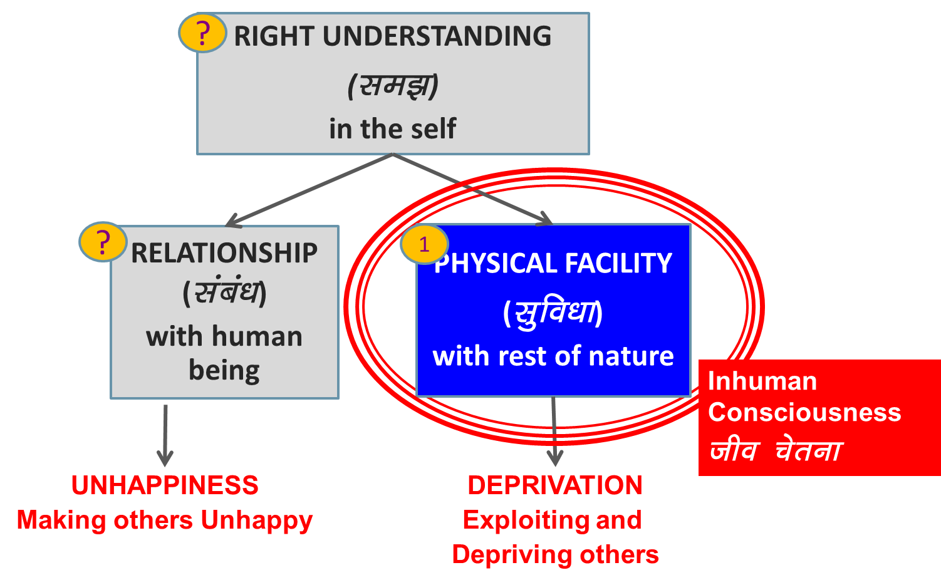
Preparation for Life
Is it sufficient to prepare for a job (physical facility) or ensure development of all 3? (and be equipped to live with fulfillment in oneself + in the family-society-nature)
Transformation& Progress
परिमार्जन-विकास
Do you need to make effort for it?
Should education help you to make this effort?

Slide 22
Education: Understanding and Learning
PROGRAM:
Understanding Harmony
RIGHT UNDERSTANDING
(le>)
in the self
Understanding Harmony:
Harmony in Human Being
Harmony in Family
Harmony in Society
Harmony in Nature/Existence
VALUES
1
Understanding
2
3
RELATIONSHIP (laca/k)
with human being
PHYSICAL FACILITY
(lqfo/kk)
with rest of nature
Living in Harmony
all 4 levels:
Individual
Family
Society
Nature/Existence
SKILLS
Learning
MUTUAL HAPPINESS
(mHk; lq[k)
MUTUAL PROSPERITY
(mHk; le`f))

Slide 23
Sum Up

Slide 24
Sum Up
Basic Human Aspiration Continuous Happiness and Prosperity
Fulfilment of Right Understanding Relationship Physical
Basic Human Aspiration Facility
Happiness to be in Harmony
Understanding Values What is Valuable for Human Being, What to Do
Learning Skills How to Do

Slide 25
Foundation for Life-ready Graduates
UHV-I: has a brief introduction to “right understanding” [15 sessions]
Faculty Mentorship One UHV faculty mentor (guardian, guide from same department)
Program for every 20 newly joined students
Weekly interaction
Mentorship throughout period of study (e.g., 4 years for BTech)
Student Buddy Program One senior student (elder sibling) for every 5 newly joined students
Daily/weekly interaction
HHH-I: Orientation to Holistic Human Health [15 sessions]
UHV-II: is a 1-semester 3-credit Foundation Course in [42 sessions]
Human Values and Professional Ethics
Socially Relevant Projects

Slide 26





For More Information
https://ichvhe.uhv.org.in/
https://uhv.org.in/
https://fdp-si.aicte-india.org/index.php
https://www.youtube.com/c/UniversalHumanValues
ichvhe2024@gmail.com
uhvfoundation@gmail.com
ichvhe.uhvfoundation@uhv.org.in

Slide 27

UHV-II: A Foundation Course in Human Values and Professional Ethics
1 Semester, 3 credit course, L-T-P-C: 2-1-0-3
28 lectures
14 practice sessions (practical)
Organised in 5 modules
To be taught by trained UHV-II faculty
in 1st, 2nd, 3rd or 4th semester of professional colleges
In 1st, 2nd professional of medical education…
Related FDPs
UHV-II FDP 8-days f2f or 5+5 days online
UHV-Introduction 3-days f2f or 5-days online
Free Download
https://uhv.org.in/Uhve.php

Slide 28
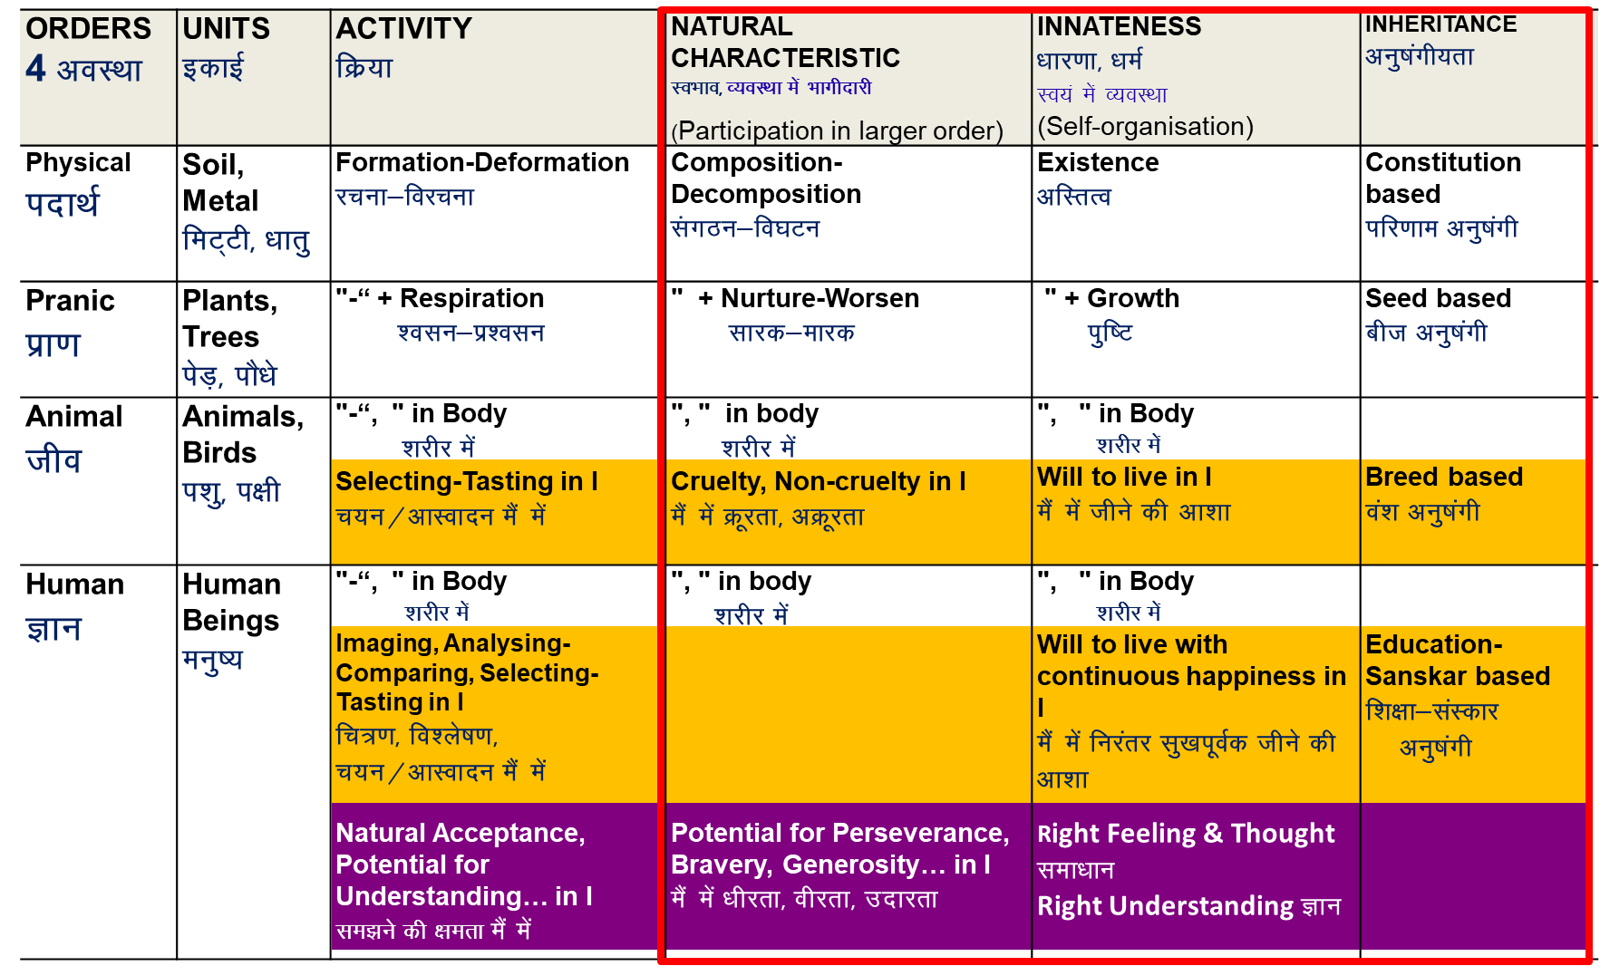
In UHV-II, We explore…
To understand the inherent harmony in nature and to live accordingly (sustainably), we need:
To facilitate a conducive environment for the activity (at least not violate it) of all orders
To facilitate the innateness (or at least not violate it) of all orders
To facilitate the inheritance (or at least not violate it) of all orders

Slide 29
Order | Human Participation for Harmony, Mutual Fulfillment
Physical Order | Facilitate its existence by ensuring conducive environment and maintaining / ensuring its constitution (eg. constitution of earth)
Bio Order | Facilitate its growth by ensuring conducive environment and maintaining / ensuring its seed (e.g. seed of rice)
Animal Order | Facilitate care of the body by ensuring physical facility, environment for existence & growth of body. To ensure its will to live Maintaining / ensuring its breed (eg. breed of cow)
Human Order | Facilitate care of the body by ensuring physical facility, environment for existence & growth of body Facilitate its will to live with continuous happiness by ensuring human education-sanskar, ensuring realization within and participating in developing / maintaining a humane society

Slide 30
Explore
Masanobu Fukuoka (Japan): The One-Straw Revolution
Padma Shri Subhash Palekar (Maharashtra): Zero Budget Natural Farming (ZBNF)
Allan Savory (Zimbabwe): Reversing Desertification through Planned Grazing
Shyam Sundar Reddy (Telangana): Probiotic Farming
Al Gore (USA): An Inconvenient Truth
Notes:
India has witnessed a significant movement towards natural farming, led by several dedicated individuals who have championed sustainable agricultural practices. Notably, some of these pioneers have been honored with the prestigious Padma Shri award for their contributions. Here are some key figures:(bio4climate.org)
🌿 Padma Shri Awardees in Natural and Sustainable Farming
Subhash Palekar (Maharashtra)
A former agricultural scientist, Subhash Palekar is renowned for developing and promoting Zero Budget Natural Farming (ZBNF), which emphasizes farming without chemical fertilizers and pesticides. He was awarded the Padma Shri in 2016 for his contributions to agriculture.
Sanjay Anant Patil (Goa)
Known as the “One-Man Army,” Patil transformed a ten-acre barren land into a lush farm using natural farming techniques and a zero-energy micro-irrigation system. He was conferred the Padma Shri in 2024.
Kamala Pujari (Odisha)
A tribal farmer from Koraput district, Pujari preserved hundreds of indigenous paddy varieties and promoted organic farming practices. She received the Padma Shri in 2019.
Amai Mahalinga Naik (Karnataka)
Despite being illiterate, Naik single-handedly developed an organic farm on barren land by digging tunnels to access water, earning him the nickname “Tunnel Man of Karnataka.” He was awarded the Padma Shri in 2022.
Sundaram Verma (Rajasthan)
An environmentalist who developed a dryland agroforestry technique, enabling tree plantation with just one litre of water per plant. He was honored with the Padma Shri in 2020.
🌾 Other Notable Advocates of Natural Farming
Vandana Shiva
An environmentalist and author, Shiva has been a vocal advocate for organic farming, seed sovereignty, and sustainable agriculture through her organization, Navdanya. (en.wikipedia.org)
Ramisetti Murali (Andhra Pradesh)
A social worker and environmental activist, Murali has been involved in promoting sustainable farming practices and water conservation through his organization, Modern Architects for Rural India (MARI). (en.wikipedia.org)

Slide 31

Course in Holistic Human Health
HHH-I: Orientation to holistic human health [15 sessions]
+
HHH-II: A Foundation Course in Holistic Human Health
(1 Semester, 3 credit course, L-T-P-C: 2-1-0-3) [42 sessions]
To be taught by trained HHH faculty
in 1st, 2nd, 3rd or 4th semester of professional colleges
In 1st, 2nd professional of medical education
Health of self + body + Environment (family, society, nature)
Universal health principles
Recommendations
Health tracker
Free Download
https://uhv.org.in/foundation/course

Slide 32
Explore
T Colin Campbell and Dr. Caldwell Esselstyn (USA): Forks over Knives
Notes:
India has witnessed a significant movement towards natural farming, led by several dedicated individuals who have championed sustainable agricultural practices. Notably, some of these pioneers have been honored with the prestigious Padma Shri award for their contributions. Here are some key figures:(bio4climate.org)
🌿 Padma Shri Awardees in Natural and Sustainable Farming
Subhash Palekar (Maharashtra)
A former agricultural scientist, Subhash Palekar is renowned for developing and promoting Zero Budget Natural Farming (ZBNF), which emphasizes farming without chemical fertilizers and pesticides. He was awarded the Padma Shri in 2016 for his contributions to agriculture.
Sanjay Anant Patil (Goa)
Known as the “One-Man Army,” Patil transformed a ten-acre barren land into a lush farm using natural farming techniques and a zero-energy micro-irrigation system. He was conferred the Padma Shri in 2024.
Kamala Pujari (Odisha)
A tribal farmer from Koraput district, Pujari preserved hundreds of indigenous paddy varieties and promoted organic farming practices. She received the Padma Shri in 2019.
Amai Mahalinga Naik (Karnataka)
Despite being illiterate, Naik single-handedly developed an organic farm on barren land by digging tunnels to access water, earning him the nickname “Tunnel Man of Karnataka.” He was awarded the Padma Shri in 2022.
Sundaram Verma (Rajasthan)
An environmentalist who developed a dryland agroforestry technique, enabling tree plantation with just one litre of water per plant. He was honored with the Padma Shri in 2020.
🌾 Other Notable Advocates of Natural Farming
Vandana Shiva
An environmentalist and author, Shiva has been a vocal advocate for organic farming, seed sovereignty, and sustainable agriculture through her organization, Navdanya. (en.wikipedia.org)
Ramisetti Murali (Andhra Pradesh)
A social worker and environmental activist, Murali has been involved in promoting sustainable farming practices and water conservation through his organization, Modern Architects for Rural India (MARI). (en.wikipedia.org)

Slide 33
Foundation Courses
Advanced Courses, Minor Degree in UHV
UHV-I: Introduction to Universal Human Values
(part of the Student Induction Program)
[15 sessions]
HHH-I: Orientation to Holistic Human Health
[15 sessions]
UHV-II: Foundation Course in Human Values and Professional Ethics: Understanding Harmony and Ethical Human Conduct
[42 sessions]
Notes: To highlight the importance of values, in its model curriculum, AICTE has made a special provision of 3-credits exclusively for UHV-II and placed it as a mandatory course
May be offered as value-added courses (contribute to fulfilling NAAC criteria 1, 2, 3, 6 and 7)
UHV-III: Understanding Human Being, Nature and Existence Comprehensively
UHV-IV: Vision for Humane Society (which is just and equitable)
UHV-V: Human Values in Different Philosophies (Darshans) like:
  Vedic Darshans – Jain and Baudh Darshans
  Madhyasth – Abrahmic and Modern…
UHV-VI: Human Psychology – Leading to Full Human Potential
HHH-II: A Foundation Course in Holistic Human Health – Its Philosophy and Practice
UHV-VII (B): Human Sociology – Leading to Justice
UHV-VIII: Human Economics – Sustainable and Mutually Enriching Production Systems

Slide 34
More for the Faculty

Slide 35
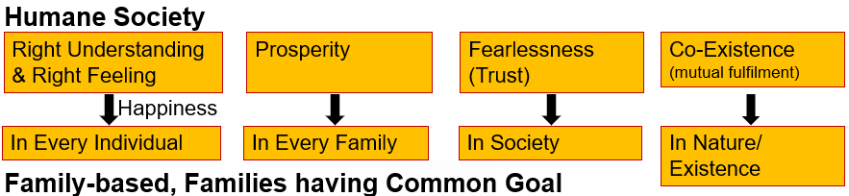
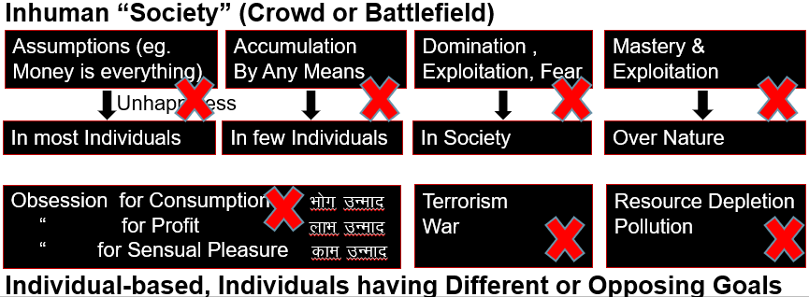
Basic Human Aspiration
Concerns, Problems
Happiness, Prosperity → Continuity
Humane Society
Tension, depression
Rivalries in relationship
Terrorism and war
Global warming and climate change
Inhuman Society…

Slide 36
Current State – Have we understood our Aspirations?
Humane Society
Family-based, Families having Common Goal
Inhuman “Society” (Crowd or Battlefield)
Individual-based, Individuals having Different or Opposing Goals
Right Understanding & Right Feeling
Prosperity
Fearlessness
(Trust)
Co-Existence
(mutual fulfilment)
Happiness
In Every Individual
In Every Family
In Society
In Nature/ Existence
Assumptions (eg. Money is everything)
Accumulation
By Any Means
Domination ,
Exploitation, Fear
Mastery &
Exploitation
Unhappiness
In most Individuals
In few Individuals
In Society
Over Nature
Obsession for Consumption Hkksx mUekn
“ for Profit ykHk mUekn
“ for Sensual Pleasure dke mUekn
Terrorism
War
Resource Depletion
Pollution
Notes:
Key point is that most of the problems we see around us are due to lack of clarity of human goal.
We don’t have to harp on the specific problems - Let participants explore the current state.
Don’t spend too much time on this slide

Slide 37
Crucial Role of Education
Present State raises Qs about Education
Holistic, Value-based Education
Understanding of human values
Vision for value-based living
Skills and practice for value-based living
Definite, human conduct
Humane society
Present Education
Confusions, contradictions…?
Materialistic world-view?
Skills and practice merely for living?
Indefinite, inhuman conduct?
Present society (achievements…problems…)?
Crucial Missing Link
?
Human Values = Participation of human being for harmony in the larger order (family, society, nature…)

Slide 38

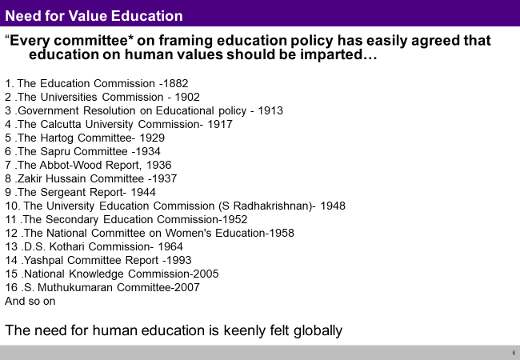
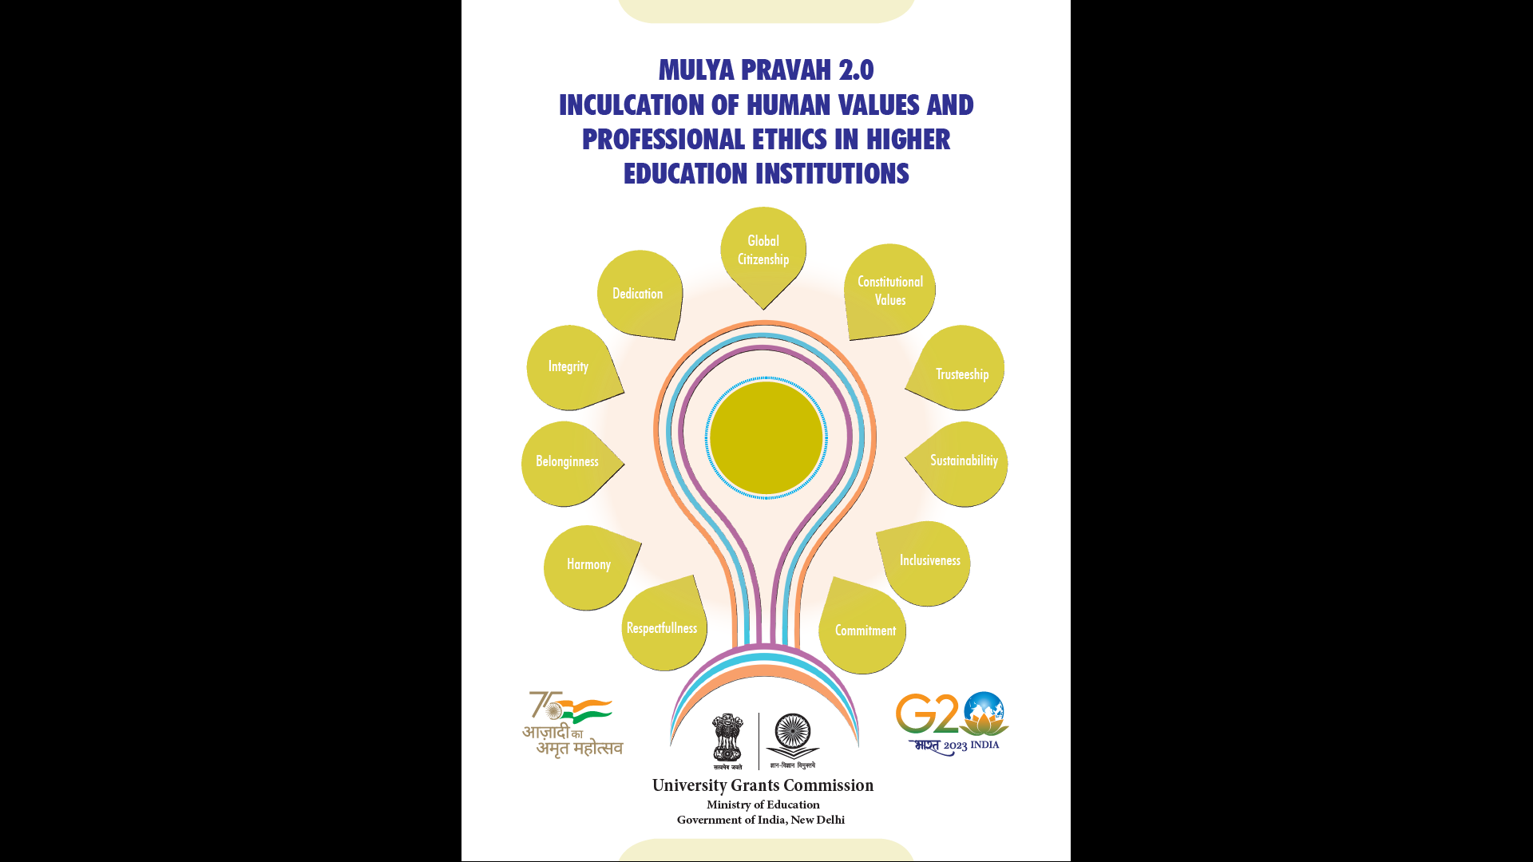
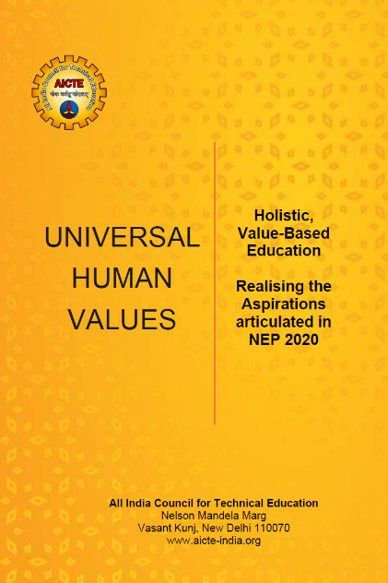


Need for Human Values is Felt Globally
These multiple articulations have a common core, though some basic assumptions and focus may differ.
With this situation, it is imperative to
  Appreciate the different approaches and achievements
    (to whatever extent the basic human values have been articulated)
  Be complimentary, help to fill the gaps
  (rather than to compare, criticise or reject)

Slide 39
The Need and Vision is well articulated in National Education Policy 2020
Education is fundamental for achieving
        full human potential,
        developing an equitable and just society,
        and promoting national development
  …an education system rooted in Indian ethos to transform India…
  Value-based education will include the development of humanistic, ethical, Constitutional, and universal human values…
  …develop a deep sense of respect towards the Fundamental Duties and Constitutional Values… and global well-being

Slide 40
Holistic, Value-based Education – Filling the Crucial Missing Link in Education
Holistic, Value-based Education
Holistic, humane world vision
Human values (participation)
Skills for living with human values
Definite, human conduct
Humane society
Crucial Missing Link
1
Universal Human Values (UHV)
Universal
Rational
Verifiable
Leading to Harmony
Reinforcement and Exemplification of Living in Harmony, e.g., from Tradition
Happiness, Prosperity…
2
3
Value-guided Skills – Education and practice of
human friendly and nature friendly skills
Equitable and just society
(village… block… city… district… state… Nation… World)
National development
(in harmony within, in harmony with other nations,
complimentary to other nations)
Participation in the society

Slide 41
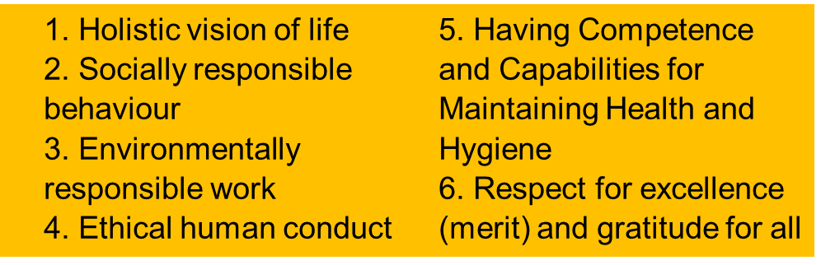
Outcome of Holistic, Value-based Education
At the level of individual human being: Human Consciousness Full Human Potential
Happiness and prosperity → continuity
At the level of society: Human Society Equitable and Just Society
-------Happiness------- ------------------------Conditions of Happiness---------------------------
At the level of the Nation Promoting National Development
        Peace and harmony within the nation and complementarity with other nations
Right Understanding & Right Feeling
Prosperity
Fearlessness
(Trust)
Co-Existence
(mutual fulfilment)
Happiness
In Every Individual
In Every Family
In Society
In Nature/ Existence

Slide 42
Early Efforts for Human Values in Technical Education
1980+ IIT Delhi “Science and Humanism”
(now called “HUL 371: Science, Technology and Society”)
2005+ IIIT Hyderabad “Human Values & Professional Ethics (HVPE)”
2009+ IIT Kanpur “Universal Human Values” through NSS and
more recently “MBA618A: Introduction to Universal Human Values and Ethics”
2010 IIT Delhi Board of Governors Meeting…
2011+ UHV at Punjab Technical University
By 2017 forty institutions were experimenting with the UHV Foundation Course
2017+ UHV at AICTE enabled National reach… under the leadership of Prof. Sahasrabudhe and it is being taken to a larger scale now under Prof. TG Sitharam

Slide 43




AICTE’s Efforts for Human Values (2017-2022)
2017 Induction Program Cell and 2 National Committees
with a clear vision for value education for value-based living
  NC-UHV (to develop content, processes) and
  NCC-IP to coordinate implementation along with teams for regional and national coordination
  UHV-I is part of the Student Induction Program in the model curriculum
  UHV-II is a 1-semester 3-credit course in the model curriculum
  (AICTE allocated 3 exclusive credits for UHV-II)
2020 Online programs started (value-ona)
2020 Online Morning Session for practical practice started
2022 UHV Minor Degree in UHV initiated
(development work started)

Slide 44
AICTE’s Efforts for Human Values (continued, 2023 Onwards)
2023 Clear vision, implementation document released
at Akhil Bharitiya Shiksha Samagam
Target to Reach UHV to all Institutions associated with AICTE
2023 Self-funded face-to-face programs (FDPs, MDPs & LDPs) started
2023 Translation of UHV material into 9 Indian languages started
2023 Extension work in Rajya Anand Sansthan, GoMP
2024 UHV Cell established at AICTE to focus on UHV
(IP Cell separated to focus on induction with other efforts)
2025 Practical Practice in UHV being strengthened

Slide 45
Key Assets (as of May 2025)
Vision: Human education for a humane society
Volume: 37 promising institutions, 90,000 faculty, 7-9 lakh students/year
Interest: 240 universities appoint UCs, UHV courses at 4000+ institutions
Developed: 16 books, 8 courses for Students, 12 types of FDPs
Conducted: 900+ FDPs, Face-to-face FDPs in ‘22-25: 298
Process: Self-exploration
UHV Team – Network of volunteers (honorary, pro-bono) 500+
Program: Value education → value-based education → value-based living
298 Self funded
32 AICTE funded
Resource Persons, Coordinators, Technical…

Slide 46



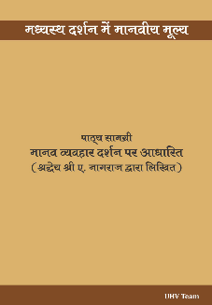
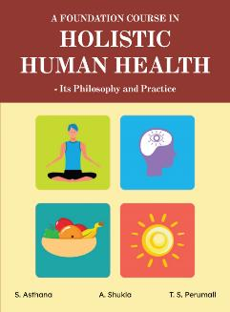

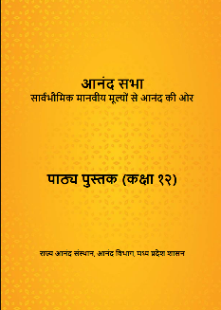
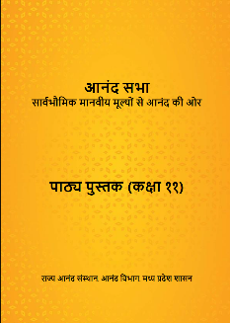
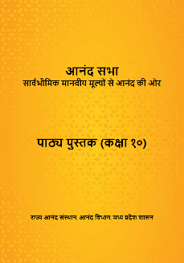


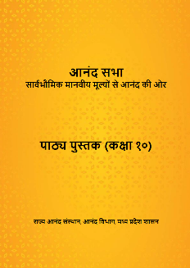
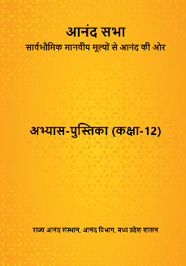



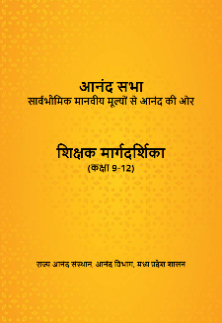

Content Updated/Developed – Books, Workbooks, Teachers’ Manuals…
3rd Edition
Being prepared
New
New
New
3rd Edition
3rd Edition
Being translated into 9 Indian Languages
New
4 new books for Class 9-12
4 new books for Class 9-12

Slide 47
Foundation Courses
Advanced Courses, Minor Degree in UHV
UHV-I: Introduction to Universal Human Values
(part of the Student Induction Program)
[15 sessions]
HHH-I: Orientation to Holistic Human Health
[15 sessions]
UHV-II: Foundation Course in Human Values and Professional Ethics: Understanding Harmony and Ethical Human Conduct
[42 sessions]
Notes: To highlight the importance of values, in its model curriculum, AICTE has made a special provision of 3-credits exclusively for UHV-II and placed it as a mandatory course
May be offered as value-added courses (contribute to fulfilling NAAC criteria 1, 2, 3, 6 and 7)
UHV-III: Understanding Human Being, Nature and Existence Comprehensively
UHV-IV: Vision for Humane Society (which is just and equitable)
UHV-V: Human Values in Different Philosophies (Darshans) like:
  Vedic Darshans – Jain and Baudh Darshans
  Madhyasth – Abrahmic and Modern…
UHV-VI: Human Psychology – Leading to Full Human Potential
HHH-II: A Foundation Course in Holistic Human Health – Its Philosophy and Practice
UHV-VII (B): Human Sociology – Leading to Justice
UHV-VIII: Human Economics – Sustainable and Mutually Enriching Production Systems

Slide 48
Addressing the Need for Human Values in Education
Pro-active [Aspiration-centric]
  UHV Foundation courses (UHV-I, UHV-II, Holistic Human Health…)
  UHV Advanced courses / Minor Degree (UHV-III to UHV-VIII)
Active [Aspiration-centric Concern]
  Faculty Mentoring
  Student Buddy
Post-active [Concern-centric Aspiration]
  Counselling level 1 (UHV-based, CBT, or other means)
  Counselling level 2 (UHV-based with professional help, may include drugs)
Re-active [Concern-crisis)
  Professional Care

Slide 49
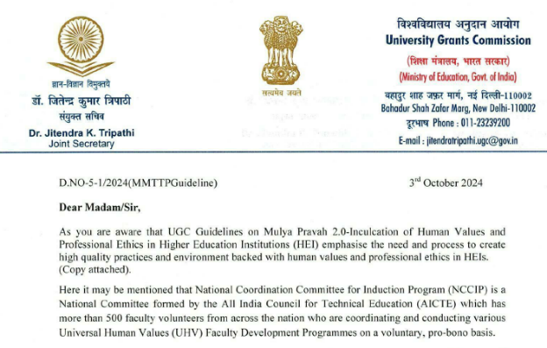
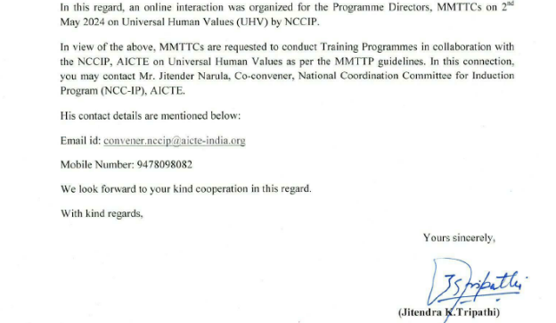
UGC Adopts UHV to Prepare Faculty for Human Values and Professional Ethics

Slide 50
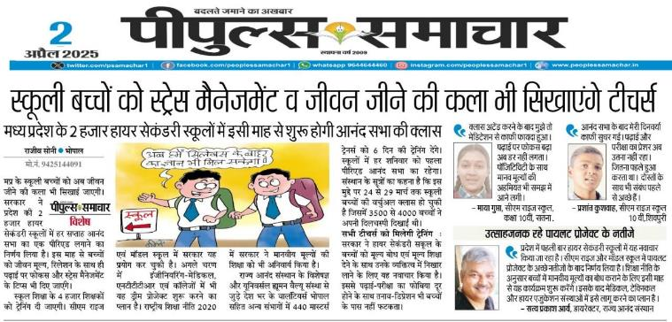
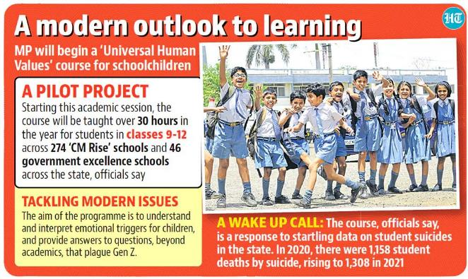
UHV Introduced in MP Schools – 30 Session Program for Cl 9-12
UHV Introduced in MP Schools – “Anand Sabha” a 30 Session Program for Cl 9-12
In collaboration with Rajya Anand Sansthan, Govt. of MP
2025 – 2000 Schools
2023 – 320 Schools
Textbook and workbook for each class
Teacher orientation
Familiarisation of principals/DEOs/JDs…

Slide 51
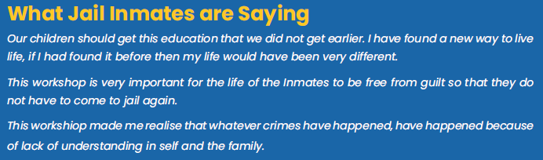
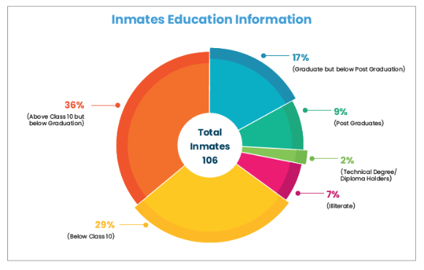
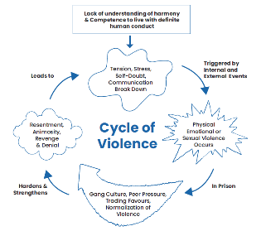
UHV Workshops for Jail Inmates – Experience from Kanpur Jail
64% inmates are educated (class 10 or beyond)
28% inmates are graduates, post graduates or having a technical degree
This raises the question about the education
and the need to make it holistic and value-based…

Slide 52

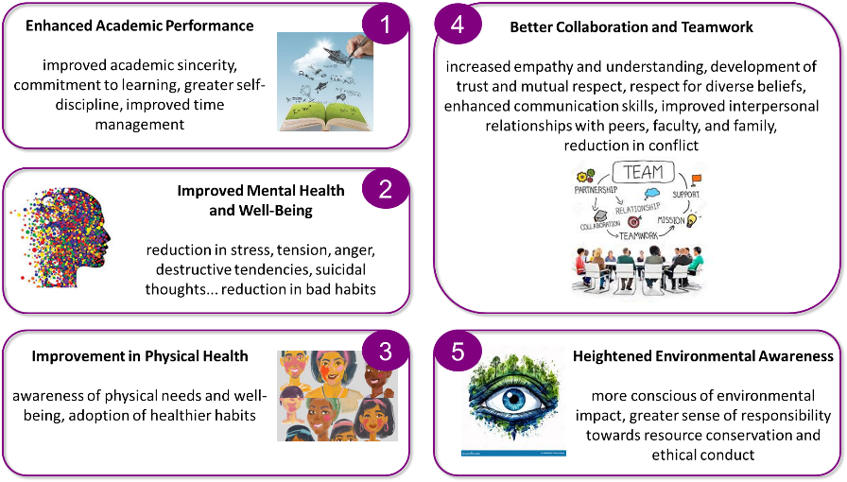
IRMA Evaluated AICTE’s Efforts on Universal Human Values
“UHV helps in the development of a holistic, humane vision of life,
understanding the purpose of life, and
a shift from materialistic to meaningful goals”
5 Key Findings
IRMA conducted a
quantitative study
and a
longitudinal study
covering a sample of over
27,036 faculty
11,000 students
of 5,325 institutions
from 34 states and union territories of the Nation
Notes:
Emergence: Overall Impact of Universal Human Values (UHV) on Students at SRMIST & AKGEC
Introduction
The Universal Human Values (UHV) program has brought profound transformations to students at SRMIST and AKGEC, helping them develop clarity in aspirations, emotional intelligence, ethical decision-making, and a commitment to sustainability. This report combines real-life experiences and testimonials from students at both institutions, highlighting the widespread positive impact of UHV education.
1. Clarity in Aspirations and Self-Discovery
Student: Tashi Modi (SRMIST, MBBS 1st Year)
Incident: Tashi, living far from home, initially focused only on academic success. UHV shifted her mindset toward holistic personal growth.
Testimonial:
"I realized that my purpose here extends beyond just achieving good grades; it’s about becoming a person in tune with myself, others, and nature’s harmony."
Student: Vikas Kumar (AKGEC, UHV Workshop Participant)
Incident: Vikas realized that most of his decisions were influenced by peer pressure, not his true aspirations.
Testimonial:
"I came to know about my swabhav (Natural Acceptance) here and could see that most of my decisions were due to external pressures. Now, I understand that my aspirations should align with my inner self, not external influences."
👉 Impact: Students from both institutions gained clarity in aspirations, reducing stress and focusing on personal growth and relationships.
2. Overcoming Peer Pressure and Redefining Success
Student: Shalom Elisa Anish (SRMIST, MBBS 1st Year)
Incident: Shalom initially viewed success as competition and achievements. UHV helped her understand that true success is rooted in self-harmony, values, and relationships.
Testimonial:
"Before UHV, I thought happiness was tied only to achievements, and success meant competition. After UHV, I see happiness as self-harmony and values. I now feel that I am living life in a purposeful way."
Student: Ms. Shalu (AKGEC, UHV Workshop Participant)
Incident: Shalu realized that she had been chasing external validation, which made her unhappy.
Testimonial:
"I started copying others under peer pressure, which made me unhappy. I now understand that happiness should come from within, not external validation."
👉 Impact: Students developed a broader perspective on success and happiness, moving from competition-driven mindsets to value-based, cooperative thinking.
3. Strengthening Emotional Intelligence and Relationships
Student: Harinishree Meenakshi Sundar (SRMIST, Biomedical Engineering 2nd Year)
Incident: Harinishree realized the importance of self-love, trust, and respect, which helped her build better relationships.
Testimonial:
"Through this program, I have recognized the importance of self-love, trust, and respect. Exploring these topics has opened new horizons for personal growth and confidence."
Student: Anonymous (AKGEC, UHV Participant)
Incident: A student who frequently argued with parents learned active listening and empathy, transforming their relationship.
Testimonial:
"Earlier, I always felt my parents didn’t understand me. But after UHV, I realized I never tried to understand them either. Now, we communicate much better."
👉 Impact: Students at both institutions developed stronger emotional intelligence, empathy, and healthier relationships.
4. Ethical Clarity in Professional and Personal Life
Student: Soham Wagh (SRMIST, Networking and Communications 3rd Year)
Incident: Initially skeptical of UHV, Soham discovered its deep personal impact through self-reflection exercises.
Testimonial:
"At first, I thought UHV was just another formality. But learning about Natural Acceptance changed how I approach decisions, making me more aware and confident."
AKGEC Alumni (UHV Participant)
Incident: A former student applied UHV lessons in the workplace, handling conflicts with patience and understanding.
Testimonial:
"At my workplace, I used to get frustrated when my manager criticized me. After UHV, I started understanding his perspective rather than reacting emotionally. This helped me handle criticism better."
👉 Impact: Students learned ethical clarity and resilience, enabling them to handle academic, professional, and personal challenges more effectively.
5. Commitment to Sustainable and Ethical Living
Incident: The Eco Revive Competition (SRMIST) encouraged students to turn waste materials into functional items, promoting sustainability.
🔹 Student Testimonial:
"Eco Revive helped me understand the importance of sustainability and how small actions like upcycling can make a big difference."
Incident: A group of AKGEC students planted 25 trees and committed to caring for them, promoting environmental responsibility.
🔹 Student Testimonial:
"After learning about sustainable living in UHV, I realized how much water I was wasting. I now ensure I use every drop and raise awareness in my neighborhood."
👉 Impact: Students became more environmentally responsible, applying UHV principles to sustainability and community service.
Conclusion
The UHV program at SRMIST and AKGEC has led to remarkable student transformations, including: ✅ Greater self-awareness and clarity of aspirations.
✅ Stronger emotional intelligence and relationship-building.
✅ Ethical decision-making skills for academic and professional growth.
✅ Overcoming peer pressure and redefining success in a holistic way.
✅ Commitment to sustainability and ethical living.
These real-life incidents and testimonials show that UHV is not just a subject—it is a life-changing experience that empowers students to lead meaningful, responsible, and balanced lives.

Slide 53
Observations on IRMA Impact Study by AICTE Steering Committee (held 2-3 Dec 2024)
“The committee advocates for extending UHV courses to all higher education institutions, not just technical ones and views AICTE’s role as an initiator and prototype developer, with the ultimate goal of broader adoption across the education system (pt 7)”.
“The committee agrees with the recommendation to extend the program to the K-12 level, particularly from the 9th grade onwards to create a deeper and longer-lasting impact (pt 6)”

Slide 54
Core Outcomes of UHV Approach [Holistic, Value-based Education]
Aspiration for excellence (श्रेष्ठता)
vs to be special (विशेषता)
Teamwork, collaboration, and complementarity
vs competition
Balanced, holistic development
(of consciousness + material)
vs material-focused development
Humane Society – Wellbeing of All
vs accumulation for few

Slide 55
Potential
Reach every institution of higher learning
    UHV Cells in every institution – target 8000 (presently 4000)
    UHV Nodal Centers in every state – target 100 (presently potential 37)
Extend UHV to schools (presently 380, being extended to 9000 in MP)
Extend UHV to society at large (presently in a few Jails)
International Reach
(presently through the International Conference on Human Values in Higher Education)
5. Strengthen UHV Team (volunteers)
This is the Potential that we are working on as the UHV Team (of UHV Foundation) in collaboration with AICTE, UGC, Rajya Anand Sansthan, Govt. of MP, and various others

Slide 56
UHV-II: A Foundation Course in Human Values and Professional Ethics
1 Semester, 3 credit course, L-T-P-C: 2-1-0-3
28 lectures
14 practice sessions (practical)
Organised in 5 modules
To be taught by trained UHV-II faculty
in 1st, 2nd, 3rd or 4th semester of professional colleges
In 1st, 2nd professional of medical education…
Related FDPs
UHV-II FDP 8-days f2f or 5+5 days online
UHV-Introduction 3-days f2f or 5-days online
Free Download
https://uhv.org.in/Uhve.php

Slide 57
In UHV-II, We explore…
To understand the inherent harmony in nature and to live accordingly (sustainably), we need:
To facilitate a conducive environment for the activity (at least not violate it) of all orders
To facilitate the innateness (or at least not violate it) of all orders
To facilitate the inheritance (or at least not violate it) of all orders

Slide 58
Order | Human Participation for Mutual Fulfillment
Physical Order | Facilitate its existence by ensuring conducive environment and maintaining / ensuring its constitution (eg. constitution of earth)
Bio Order | Facilitate its growth by ensuring conducive environment and maintaining / ensuring its seed (e.g. seed of rice)
Animal Order | Facilitate care of the body by ensuring physical facility, environment for existence & growth of body. To ensure its will to live Maintaining / ensuring its breed (eg. breed of cow)
Human Order | Facilitate care of the body by ensuring physical facility, environment for existence & growth of body Facilitate its will to live with continuous happiness by ensuring human education-sanskar, ensuring realization within and participating in developing / maintaining a humane society

Slide 59
Explore
Masanobu Fukuoka (Japan): The One-Straw Revolution
Padma Shri Subhash Palekar (Maharashtra): Zero Budget Natural Farming (ZBNF)
Allan Savory (Zimbabwe): Reversing Desertification through Planned Grazing
Shyam Sundar Reddy (Telangana): Probiotic Farming
Al Gore (USA): An Inconvenient Truth
Notes:
India has witnessed a significant movement towards natural farming, led by several dedicated individuals who have championed sustainable agricultural practices. Notably, some of these pioneers have been honored with the prestigious Padma Shri award for their contributions. Here are some key figures:(bio4climate.org)
🌿 Padma Shri Awardees in Natural and Sustainable Farming
Subhash Palekar (Maharashtra)
A former agricultural scientist, Subhash Palekar is renowned for developing and promoting Zero Budget Natural Farming (ZBNF), which emphasizes farming without chemical fertilizers and pesticides. He was awarded the Padma Shri in 2016 for his contributions to agriculture.
Sanjay Anant Patil (Goa)
Known as the “One-Man Army,” Patil transformed a ten-acre barren land into a lush farm using natural farming techniques and a zero-energy micro-irrigation system. He was conferred the Padma Shri in 2024.
Kamala Pujari (Odisha)
A tribal farmer from Koraput district, Pujari preserved hundreds of indigenous paddy varieties and promoted organic farming practices. She received the Padma Shri in 2019.
Amai Mahalinga Naik (Karnataka)
Despite being illiterate, Naik single-handedly developed an organic farm on barren land by digging tunnels to access water, earning him the nickname “Tunnel Man of Karnataka.” He was awarded the Padma Shri in 2022.
Sundaram Verma (Rajasthan)
An environmentalist who developed a dryland agroforestry technique, enabling tree plantation with just one litre of water per plant. He was honored with the Padma Shri in 2020.
🌾 Other Notable Advocates of Natural Farming
Vandana Shiva
An environmentalist and author, Shiva has been a vocal advocate for organic farming, seed sovereignty, and sustainable agriculture through her organization, Navdanya. (en.wikipedia.org)
Ramisetti Murali (Andhra Pradesh)
A social worker and environmental activist, Murali has been involved in promoting sustainable farming practices and water conservation through his organization, Modern Architects for Rural India (MARI). (en.wikipedia.org)

Slide 60
Recommendations for Universities and Teaching Institutions

Slide 61
Recommendations for Administration
Set up University UHV Cell – Appoint University UHV Coordinators
  Prepare Policy Makers, Administration
    Host UHV-LDP, UHV-MDP
    Host UHV FDPs
  Enable the inclusion of SIP and UHV courses in curriculum, policy – BoS, Academic council
Set up Institute (College) UHV Cells – Appoint Institution (College) UHV Coordinators
  Prepare Administration, Faculty
    Host UHV-MDP
    Host UHV FDPs
  Enable the implementation of SIP and UHV courses
  Enable regional, national coordination and international coordination
For more depth on UHV, you may like to go through a complete Introductory UHV FDP

Slide 62
Recommendations for Faculty
Familiarise yourself with details of UHV – please go through
  An Introductory UHV FDP (online or f2f)
  A UHV-II FDP (online or f2f)
Keep in touch with the content, and UHV community
    Join the Weekly Meeting
    Go through the textbook and teachers’ manual
    Go through the recordings
    Go through the “How to Share Values”
Take up teaching UHV and Mentoring
    Teach the UHV-I Module of SIP
    Mentor a batch of 20 students
    Teach the UHV-II course
Self Development
    Join the Morning Session
    Volunteer for the National Effort

Slide 63
Next Steps
A UHV Cell to be formed in universities and its colleges for coordinating all UHV related efforts.
All AICTE-approved colleges are required to develop the requisite teaching capacity for both UHV-I as well as UHV-II, as indicated in the Approval Process Handbook 2020-21:
  Each college must prepare at least 1 faculty mentor for every 20 newly joined students. Faculty must be prepared from every department/ branch/ discipline (minimum Introductory UHV FDP)
  Each college must prepare at least 1 UHV-I faculty for every 60 newly joined students. Faculty must be prepared from every department/ branch/ discipline (additional UHV-I FDP)
  Each college must prepare at least 1 UHV-II faculty for every 120 newly joined students. Faculty must be prepared from every department/ branch/ discipline (additional UHV-II FDP)
  In the long run, each college can prepare UHV faculty for the Minor Degree internally. At that point, these courses may be offered internally

Slide 64
Prof. Anil D Sahasrabudhe, Chairman NAAC
https://www.youtube.com/watch?v=jgj7XiyC36I
Prof. TG Sitharam, Chairman AICTE
https://www.youtube.com/watch?v=6-ttB7IhWYE
IIT Ropar
https://www.youtube.com/watch?v=fZM4uHcTezo

